Slide 1

Lecture 02: Intelligent Agents & the Use of Search
Artificial Intelligence (CS 131)

Slide 2
Turing Test: Intelligence = Acting Humanly
Alan Turing (1950) “Computing Machinery and Intelligence”
Proposed an imitation game
Predicted that by 2000, machines could fool average person for 5 minutes, 30% of the time
One problem: not everyone agrees on the standard proposed by the test, and whether it is meaningful
In any case, we still haven’t got there yet…
Loebner prize for convincing bots would award up to $100,000 (and a gold medal) for a truly convincing interactive agent
No such agent has ever really been approached

Slide 3
What Should an Intelligent System Do?
Following Turing, we take an operational approach:
An intelligent system is one that optimizes some measure
How much it changes things so that it gets closer towards the goals that have been set for it
The word-count of error-free text translated
Customer satisfaction for automated dialogue systems
Hours of accident free, real-time driving
Amount of data collected by an autonomous space-vehicle
…
Intelligence is defined by some means of measuring performance in a set task.

Slide 4
The Agent-Based Approach to AI

Slide 5



Possible Components of an AI Agent
Perception Systems
Memory Systems &
Background Knowledge
Environment
Reasoning Systems
Action Systems
Goals & Desires

Slide 6
Judging the Best Agent
Suppose we have been given the common elements:
A precise performance measure
A sequence of world-information states (perceptions)
A starting knowledge-base for the agent
A fixed set of actions the agent can perform
The best agent is then the one that: maximizes the performance measure (1), when compared to all agents that experience the same world (2), and have access to the same knowledge (3) and have the same actions available (4)

Slide 7
Using PEAS to Describe Agents
Performance
Environment
Actuators
Sensors
Example: Autonomous automobile driving system
Performance: Hours of safe travel, obedience to laws, minimal time to destination.
Environment: Road, traffic, pedestrians, passengers.
Actuators: Vehicle turning, acceleration, braking, signals.
Sensors: Radar, video cameras, sonar, spoken-word interface for destinations, GPS.

Slide 8
Environments Vary
Fully observable or partially observable?
Chess or poker?
Deterministic or stochastic?
Pac-Man or Ms. Pac-Man?
Episodic or sequential?
Assembly line robot or autonomous automobile?
Static or dynamic?
Checkers or space exploration?
Discrete or continuous?
Backgammon or robot soccer?
Single agent or multiagent?
Mario game controller or NPC shooter team?

Slide 9
Performance Measures Vary
Goal-directed performance: a single end-point that is either achieved, or not, no matter how it is done
Winning a game of robot soccer
Clearing all levels in Pac-Man
Vacuuming the living room
Utility-directed performance: a numerical measure, which can be achieved in greater or lesser amounts
Driving a vehicle safely while arriving at finish in the least time
Achieving the highest level of customer satisfaction ratings
Exploring the greatest number of square kilometers of Mars while returning the most varied set of rock samples

Slide 10
Agents Vary
Reflex agents: pre-programmed routines for dealing with any situation they perceive in their environment
Construction robots
Roomba vacuums
Video-game NPC controllers
Memory agents: keep track of the world around them as they perceive it over time, and build up more complex knowledge & action possibilities
Autonomous vehicles
Spoken dialogue systems
Reasoning agents: represent knowledge of world and do explicit problem solving
Chess playing programs
Space exploration systems
Adaptive agents: can change their behavior over time
Learning agents for game play
Preference-learning automated assistants

Slide 11
Using Search to Solve AI Problems

Slide 12
Basic Search Techniques for AI
Search is a common method for solving AI problems
Allows precise problem formulations
Solves a variety of problems directly
Provides a simple and direct algorithm
We will first consider some uninformed search methods
No special information about the problem used
Automatic, simple ways of choosing how search will proceed
Technique relies heavily on proper problem formulation
A range of algorithms, with different performance profiles

Slide 13
Sample Problems for Search
Simple puzzles, like 8-puzzle:
Cryptarithmetic problems:
2
8
3
1
2
3
1
6
4
4
5
6
7
5
7
8
Start State
End State
O = 0 N = 6
M = 1 D = 7
Y = 2 R = 8
E = 5 S = 9
SEND
+ MORE
MONEY

Slide 14
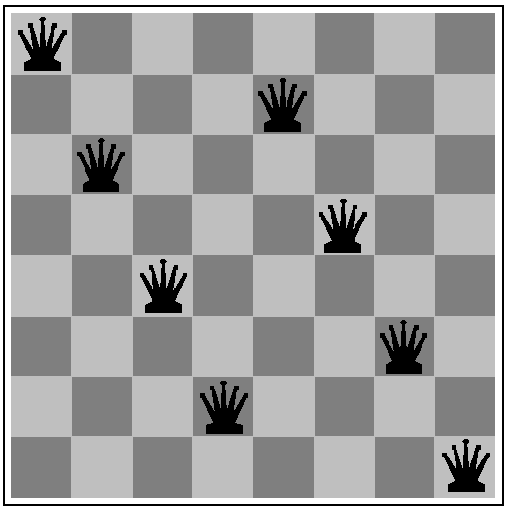
The n-Queens Problem
Place n Queens on an (n × n) chessboard, so that no two attack (are in line with) one another
Popular algorithmic benchmark
Solved via search for n ≤ 500,000
Can be solved mathematically using work of Hoffman, Loessi, & Moore (1969) for any values of n > 3
(Not a solution!
Can you find one?)

Slide 15
Real Examples
A large number of problems of real interest can be solved using search techniques:
Theorem proving in math and logic
Combinatorial optimization in chip design
Robot navigation and path planning
Resource scheduling in computing
Complex game play
Solving such problems involves re-formulating them so search techniques can be applied

Slide 16
Formalizing a Search Problem
States: the set of all things to search through
Initial state: where we starts
Goal states/tests: how we know we’ve reached solution
Actions: what things we can do to change the state, moving along some path in our search-space
Transition model: what happens when we take some action a in some state s₁ (i.e., state s₂ we end up in)
Action cost function: what it costs (if anything) to take our actions, moving from state to state

Slide 17
Solving a Search Problem
A solution to a search problem is a sequence of actions that generates a complete path from a starting state to a goal state
An optimal solution is one that has minimal overall cost
This leads to a couple of questions:
How do we balance the cost of a solution with the cost of doing the search itself?
How do we measure these costs?

Slide 18
Important Assumption: Non-negative Costs
The text (p. 65) notes that in all search problems considered, it is assumed that the cost of any search step is always some postive value c > 0, and total cost is just the sum
Why is this important?
If the cost of actions can be any value, what does an “optimal” algorithm need to do?
Note: since a negative “cost” is actually a reward, this would mean that there is no upper limit on rewards we could get
What if negative costs are allowed, but there is a lower bound, so every cost is c ≥ –ε, for some fixed value ε?
How does this affect search where infinite looping solutions are not allowed? What about when infinite loops are allowed?
Notes:
Must continue searching entire state-space (if finite) or forever (infinite)! Can’t ever prune paths, since a negative cost can always make them better.
If we know maximum depth of space (m), then any path of depth d has at most (m – d) steps left. If (–epsilon * (m – d)) is not enough of an improvement over a solution we have already found, we can then prune and ignore that path. (This only works if there are NO loops; otherwise, we could potentially find a loop that allows us to infinitely improve any solution.)

Slide 19
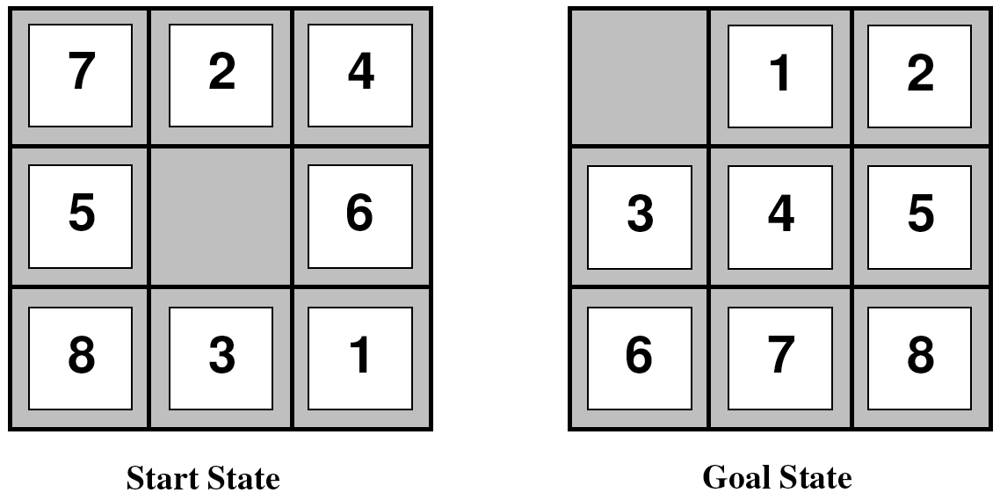
The 8-Puzzle Problem
States: arrangements of tiles
Integer sequences like: <7, 2, 4, 5, 0, 6, 8, 3, 1>
Gives 9! = 9 x 8 x 7 x … x 2 x 1 = 362880 states
Goal: sequence <0, 1, 2, 3, 4, 5, 6, 7, 8>
Actions: move blank tile in one of 4 directions
Not all moves always available
Transitions: deterministic transitions from state to state
Path cost: 1 unit per move (why?)

Slide 20
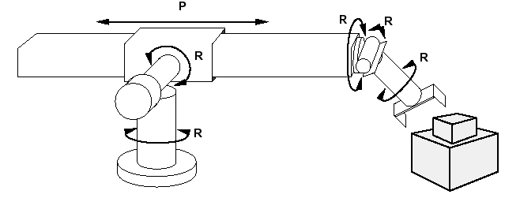
Robotic Assembly
Robot arm tasked to build a specific object out of known parts
States: combinations of positions for arm and object to build
Robotic joint angles
Location and orientation of each part
Is the space continuous? How do we handle this?
Goal: Assembled object
How do we distinguish one of many?
Actions: continuous arm movements, config₁ → config₂
Transitions: changes of the state of robot and parts, given actions
Deterministic or not?
Path cost: looking for most efficient solution
Time to construct entire object?
Most reliable solution?

Slide 21
Search Trees
A search tree represents a process using a graph
Nodes in the graph represent search up to some point
Nodes contain information:
Current state of problem
Action taken to get into state
Path-cost to get to that state
Link back to parent, i.e. the previous step in the search-path(for back-tracking purposes)

Slide 22
An Example
2
8
3
When we examine a search-node, we expand it, producing each of its successors (next nodes)
1
6
4
7
5
At each stage, we choose an unexpanded leaf node, typically avoiding repeats
2
8
3
2
8
3
2
8
3
1
6
4
1
4
1
6
4
7
5
7
6
5
7
5
The set of leaf nodes that have not been expanded yet is the search frontier
2
8
3
2
3
2
8
3
1
4
1
8
4
1
4
7
6
5
7
6
5
7
6
5

Slide 23
A General Search Technique
Image source: Russell & Norvig (2021)
Every search starts from the specified initial state of the problem
In order to track our progress, we keep track of two sets of nodes:
Frontier: nodes we know about, but haven’t expanded yet (our initial state goes into the frontier at the start of search)
Reached: nodes we have already expanded

Slide 24
A General Search Technique
Image source: Russell & Norvig (2021)
At each step, so long as we still have something left in the frontier:
We grab the next node in the frontier; these will be ordered by some priority function that defines their order
We run our goal-test on the node: if we hit the goal, we are done!

Slide 25
A General Search Technique
Image source: Russell & Norvig (2021)
If we haven’t reached the goal, we expand our node to get the other nodes that we can reach based upon our various actions
We add any new node to the frontier if:
It is a brand-new node, with a state we haven’t seen, OR
We have seen the state before, but have a lower path-cost (the new version replaces any older version in the frontier)

Slide 26
A General Search Technique
Image source: Russell & Norvig (2021)
Some searches fail!
No algorithm solves every problem
If the frontier becomes empty, we have expanded every node we can reach in the search, without ever passing our goal-test

